Slide 1
SPLEEN AFFECTIONS -part 2-
By
DR. BASSIM KADHIM

Slide 2
Splenic affections :
1- Splenic abscess:
2- Splenic cysts :
3- Splenic infarction
4- Splenic laceration and trauma

Slide 3
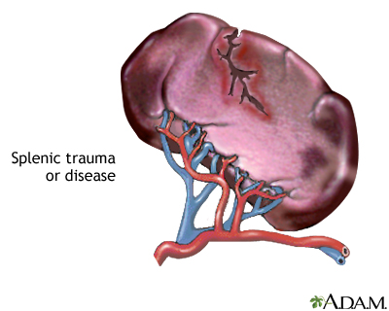
Splenic laceration and trauma :
Laceration is un common compared with trauma
Causes :
1-Secondary to abdominal penetration.
2-Iatrogenic injury during diagnostic and therapeutic procedures.

Slide 4
If it involving major splenic arteries or veins……it can be fatal.
Trt :
1- I/V fluid administration
2- Abdominal compression bandaging.
3- Serial monitoring of packed cell volume
4- blood transfusion may required.
5- Surgery intervention is considered when medical therapy failed.

Slide 5
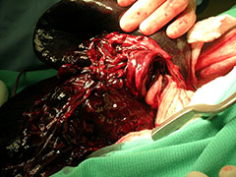
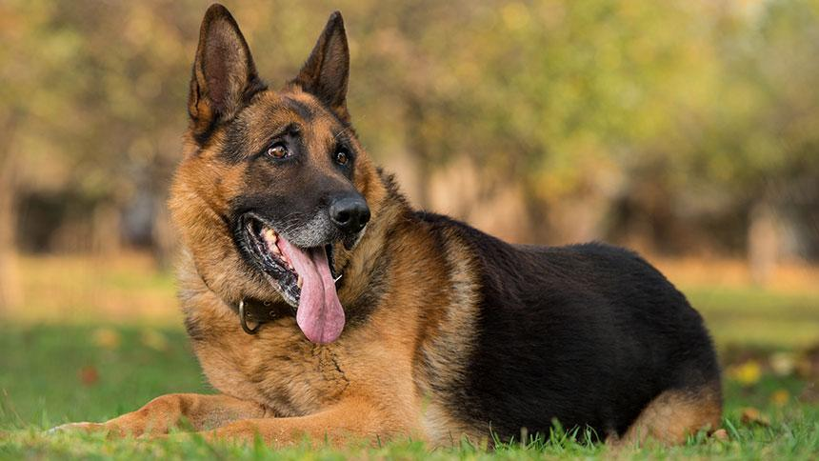
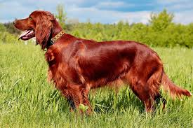
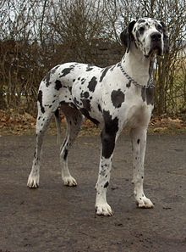
Splenic torsion :
Occur when spleen rotated around its vascular pedicle.
It most commonly reported in large or giant breed dogs ( Great Danes ,German shepherds and Irish setters).
It often associated with gastric dilation.
Increasing physical activity. ( retching, rolling and exercise), in combination with stretching of splenic ligaments may increase splenic motion.

Slide 6
Clinical signs :
It may be acute or chronic condition.
Acute :
Abdominal pain. and pale m.m.
Chronic condition :
Intermittent abdominal pain, vomiting , anorexia , abdominal distention , weight loss , polyuria , polydipsia and pale m.m.
Leukocytosis and thrombocytopenia and anemia .
Increase hepatic enzymes and pancreatic enzymes.

Slide 7
Diagnosis :
X-ray reveal :
C-shape spleen
Air opacities within splenic parenchyma
Loos of abdominal details.

Slide 8
Ultrasonography :
1- splenic congestion
2- increase of diameter of parenchymal vessels
3- Localized evidence of splenic infarction.

Slide 9
TRT :
Patient must adequately stabilized with fluid therapy or blood products.
Surgical intervention to remove splenic damage.

Slide 10
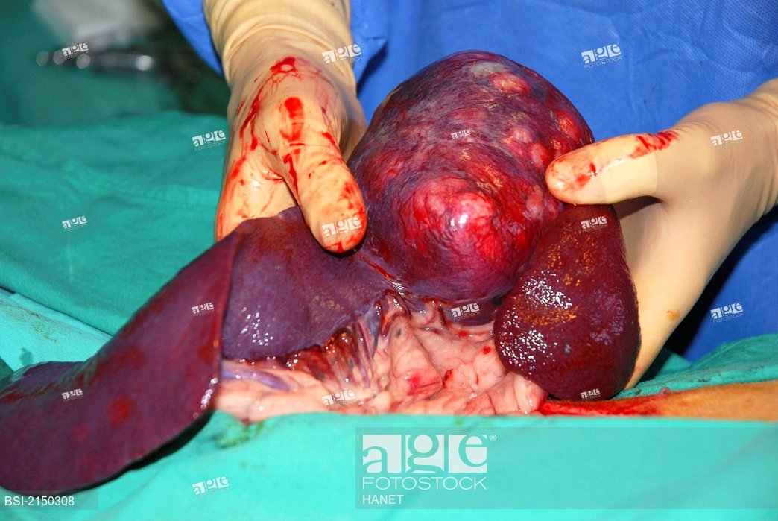
Splenic neoplasms :
They are a common condition in dogs and reach to 50% compared with cats which reach to 37%.
The most common neoplasms in dog are hemangiocarcinoma 80% .
Other neoplasms are leiomyosarcoma , fibrosarcoma ,liposarcoma
While in cats are lymphosarcoma and mast cell tumor.

Slide 11
Clinical signs :
Decrease appetite or anorexia
Weight loss
Abdominal distention
Abdominal pain
Pale m.m.
Polydipsia
Lethargy
Muscle weakness
Vomiting and cardiac arrhythemia

Slide 12
Diagnosis :
X-ray reveal :
Abdominal mass.
Mass may be difficult to identify with abdominal fluid or blood.
Pulmonary opacities
Increased sternal lymph nodes.

Slide 13
TRT :
Complete splenectomy animal will survive to 86 days and only 6% survive one year.

Slide 14
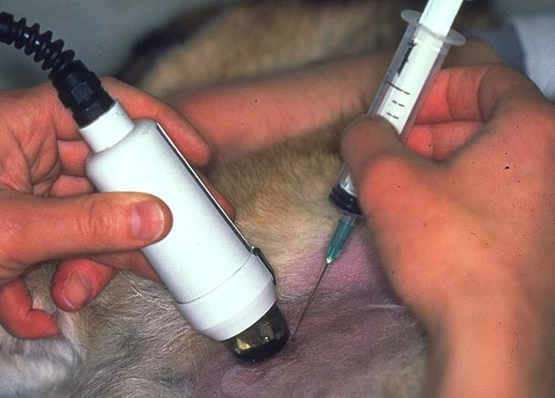
Diagnostic sampling of the spleen :
1- Closed percutaneous fine needle aspiration
2-Tru –Cut biopsy.
3- Direct surgical biopsy

Slide 15
Complications of splenectomy :
It divided into immediate and late.
Immediate :
Hemorrhage
Vascular obstruction to pancreas
Cardiac arrhythmias.

Slide 16
Late complications :
Increased bacterial infection
Hemoparasitic infection
Anemia
Sepsis
Pancreatic infarction
Increase of platelets

